Slide 1
Corona Travel
Requirements and analysis model

Slide 2
Product description
Our goal in to allow users to travel online from home via any device of their liking. They'll start by opening an app or a link and choosing a desired destination. After choosing a location, users can choose to view destination in 3D, look at some 3D photos or videos or learn some facts about the place.
Team: Sofya Donskaya, system analyst; Elena Karelina, backend developer; Danil Kireev, frontend developer; Artem Filimonov, backend developer + API integrator
Repo: https://github.com/randomunrandom/corona_travel
Report: https://docs.google.com/presentation/d/1L2dsEKCy_bkyYo2R88G_ctRGggT6wXFUKtpeL9LHwGw/edit?usp=sharing

Slide 3
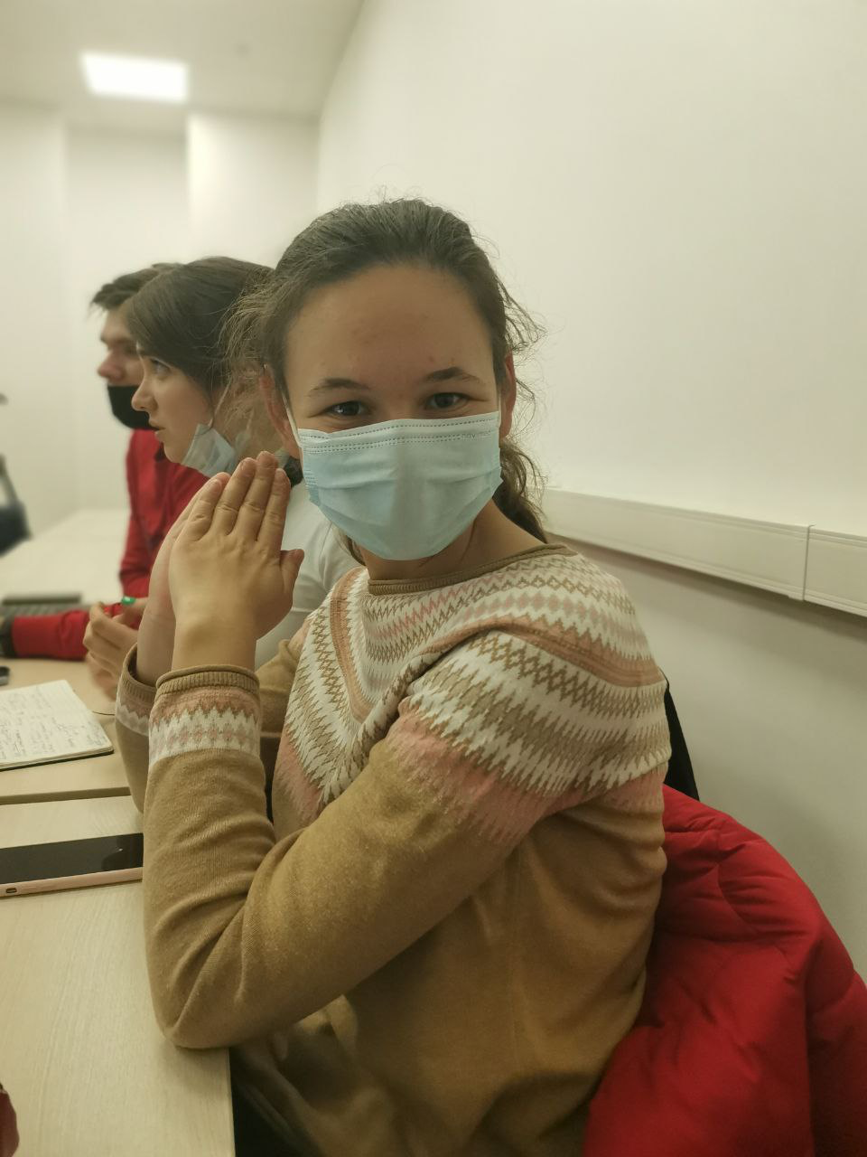

Personas
Name: Lena
21 y. o.
Software engineer student
and C++ developer
wants to go to a new country to meet new culture but can not do it because of the quarantine
Name: Sergey
38 y. o.
has 5 kids
does not have money to travel with family

Slide 4
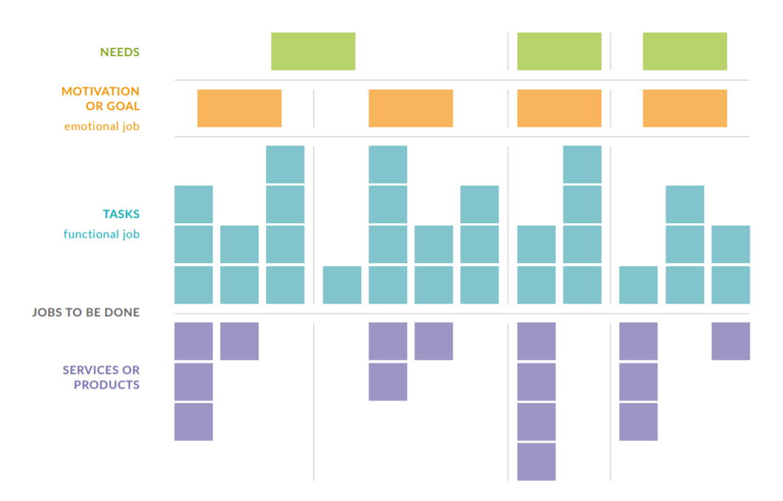
Story map
https://drawio-app.com/wp-content/uploads/2018/10/drawio-jobs-to-be-done-white-paper.pdf
At least these levels:
<persona goal/motivation>
<persona task>
---------
<product feature>
<story names w/ link>
Work products:
Draw.io / Miro / VP (skyline)
Structured text (.md) (stories)

Slide 5
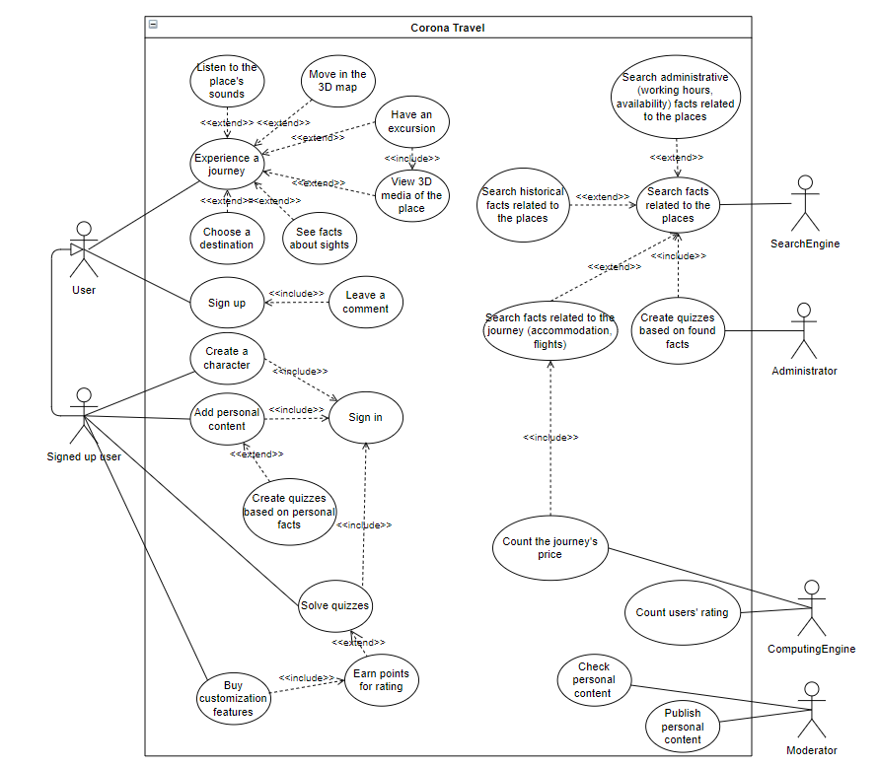
Use case diagram
Show main and alternative scenarios on a diagram
Scenarios: https://github.com/randomunrandom/corona_travel/wiki/Scenarios

Slide 6
Interaction analysis
Use case | Cooperation name | Used roles | Candidate classes
Choose journey

Slide 7
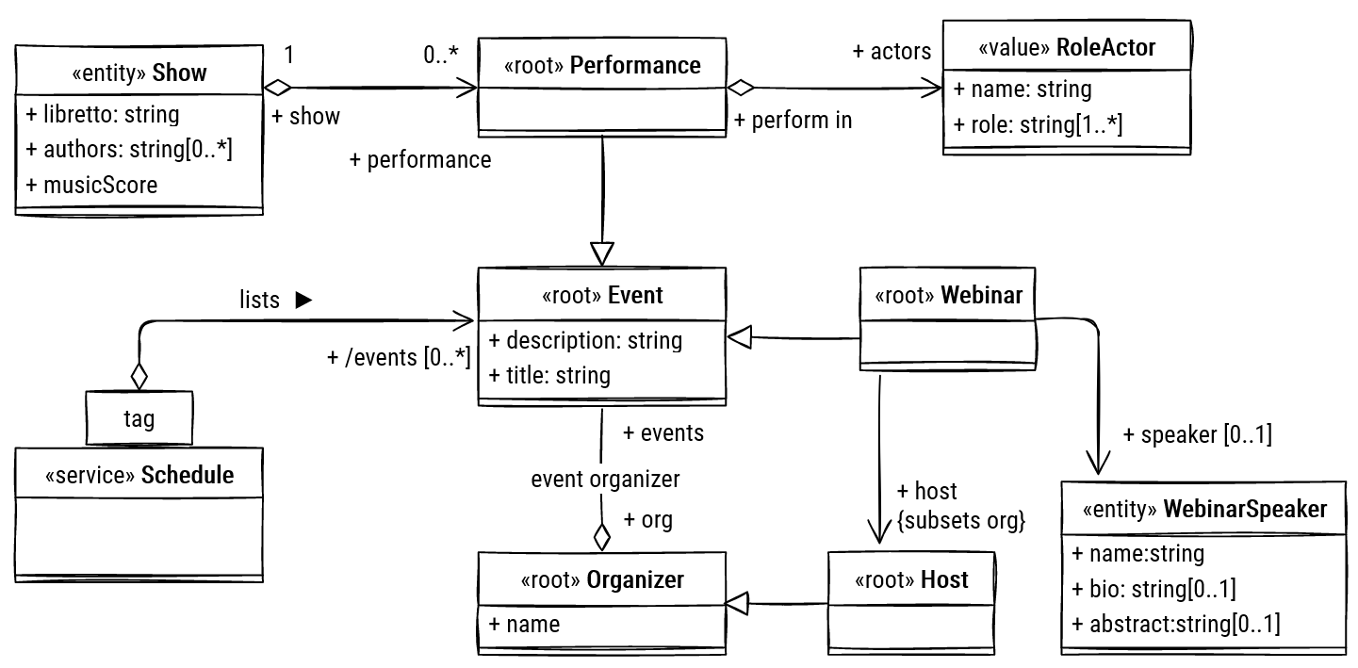
Final class diagram
The final class model should be consistent (well-formed) with interactions and use cases / stories.
Check that DDD stereotypes are set

Slide 8
Detailed behavior
Use an activity or state diagram to describe behavior of one of the dynamic classifiers in your model
Add the diagram here and explain how it works precisely in detail
Check that the overall model remains well-formed
Note: too small models may not be enough to demonstrate your qualification

Slide 9
Repository structure
Add a repo screenshot showing work products and documents from previous tasks
Demonstrate and explain how did you use tools from Task 2
Check that your project results are accessible for all course students (you may make a copy of your repo)

Slide 10
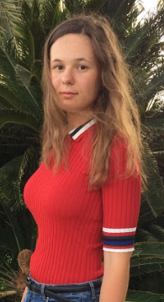
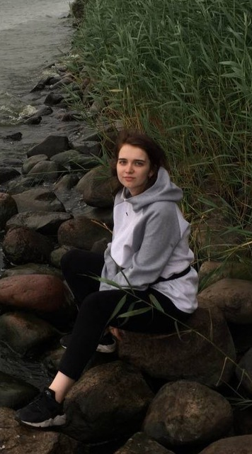
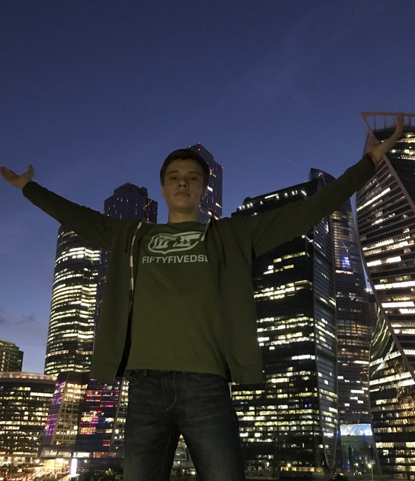

Team and roles
Elena Karelina, @e_karelina,
backend developer
Sofya Donskaya, @do_nsk,
System analyst
Artem Filimonov, @pe4enko322,
backend developer
Danil Kireev, @unrndm,
frontend developer

